Slide 1

Senior Parent Night
Class of 2026
Campbell High School

Slide 2

CHS School Counselors
A - Bk: Ms. Tasia Turner
Bl - Dol: Ms. Kimberly West
Dom - Ha: Dr. Brent Johnson
Hb - L: Ms. Michelle Dotson
M - Pem: Ms. Yolanda Wright
Pen - Sm: Ms. Rotarsha Jackson
Sn - Z: Ms. Dawn Holmgren

Slide 3
Additional Support Staff
College & Career Advisors
Kathy Young
Shirley Diaz-Brown
Support Staff
Shirley Usher (Counseling Clerk)
Sierra Saleem (Records Clerk)
Student & Family Support
Denisse Romero (Parent Resource Specialist)
Lara Fain (School Social Worker)

Slide 4
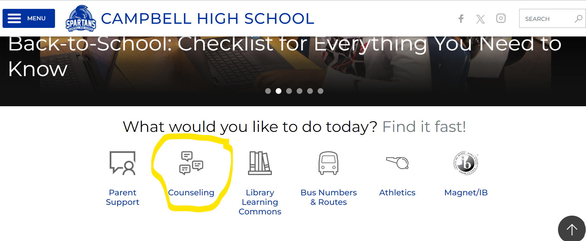
Stay Connected!
www.campbellhigh.net

Slide 5
Presentation Overview
PART I
PART II
Post-Secondary Options:
              Workforce/Apprenticeship
              Military/Armed Forces
              2-year/Technical College & Trade School
              4-year College/University
    Application Types
    Application Process
Naviance
College Search/Application
Common App Matching
Letters of Recommendation
Official Transcript Request
Sending SAT/ACT Scores
Sign up for College Visits
Paying for College
Scholarship information
CAPS Program
Events

Slide 6
Post-Secondary Options

Slide 7
Workforce/Apprenticeship
Training (provided by an employer)
On-the-job
short-term
long-term
Training can last 1 - 5 years, often paid.
The completion of an apprenticeship is generally associated with skilled labor.
These kinds of programs can lead to secure and well-paying jobs without the need for any college expenses.

Slide 8

Military/Armed Forces
              The five branches are: Air Force, Army, Coast Guard, Marine Corps, Navy
              - Reserve & National Guard are various options within
              Every branch of the military sets its own standards for enlisting, so learn about the specific requirements for each, i.e.:
              - Citizenship & Residency
              - Age limits
              - Education: You must have a high school or general equivalency diploma (GED); must have a
              degree from a four-year college to join as an officer
              -Testing Requirements: Armed Services Vocational Aptitude Battery (ASVAB) TBA @ CHS
              -Physical & Medical Requirements
              In general, students need to: (1) Make contact with a branch recruiter, (2) take the ASVAB, (3) graduate, and (4) request their final high school transcript
              Additional information can be found online at: https://www.usa.gov/military-requirements
This Photo by Unknown Author is licensed under CC BY-SA-NC

Slide 9
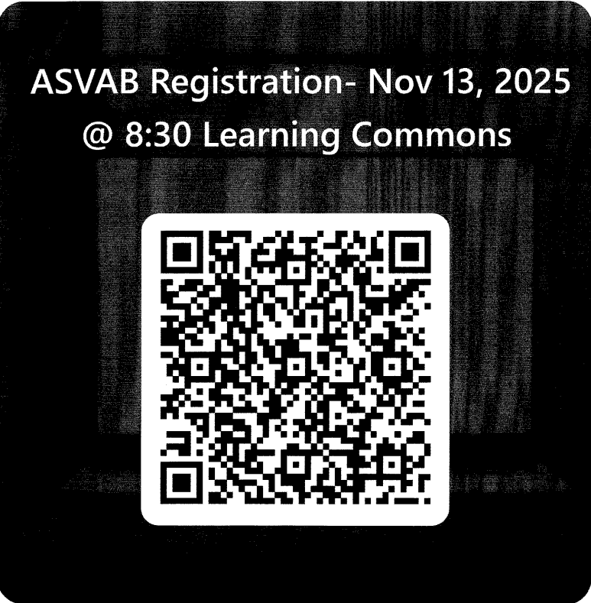
Military/Armed Forces

Slide 10
              2-year /Technical College & Trade School
              Proof of high school graduation/GED is required
                - Submit final high school transcript (Follow the transcript request process)
              Accuplacer is accepted and often offered directly from the school.
                - Less expensive than taking the SAT/ACT and serves as a placement exam vs. admissions exam. SAT/ACT exams are also accepted.
                Programs are typically career focused and completed in 2-years or less
                - Students are trained for a specific job in a career field and are immediately ready to work.
                Technical/Trade Careers include
                Aviation Criminal Justice Welding Cosmetology
                Carpentry Drafting Automotive Technician Electrician
                HVAC Technician Paralegal Horticulture Accounting
                Cybersecurity EMT/AEMT (Paramedic) Medical & Dental Assisting and more!

Slide 11
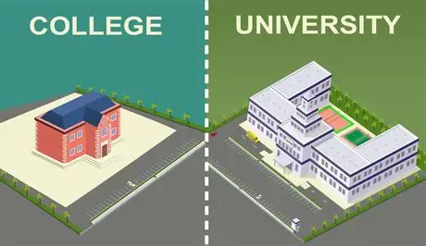
4-Year College/University
              More stringent admission requirements than other post-secondary options
                - Factors for college admission consideration:
                Rigor of classes
                Final grades/GPA
                Test scores (SAT/ACT)
                Extracurricular activities
                Essays and letters of recommendation
                Demonstrated interest
              Student Preparation
                Build a college list based on these recommendations:
                - 1 or 2 Reach Schools : Students current academic credentials fall below the school’s middle 50% range for the freshman.
                - 2 to 3 Match: Student’s current academic credentials fall within or slightly exceed the school’s middle 50% range for the freshman class.
                -Minimum 1 Safety: Student’s current academic credentials exceed the school’s middle 50% range for the freshman class, nearly guaranteeing admission
                (Check the school’s admission requirements by visiting the school’s website, as requirements vary
                from school to school and year to year)

Slide 12
4 year College University
Application Types
Early Decision I & II (Binding) – Cannot apply Early Decision to other colleges but can apply Regular Decision. If accepted for Early Decision, student must attend.
Early Action (Non-Binding) – Can apply early to other colleges and can apply regular decision. Will receive admission decision before regular decision deadlines.
Rolling Admission – Open admission, decisions given throughout the year as applicants are received and until limit set by intuition met.
Regular Decision – Standard deadline date established by the institution, with no priority or early
Priority Deadline –Similar to rolling admissions, but priority consideration around financial aid, housing, etc. is typically offered to these applicants

Slide 13
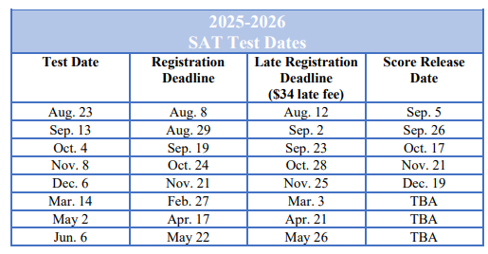
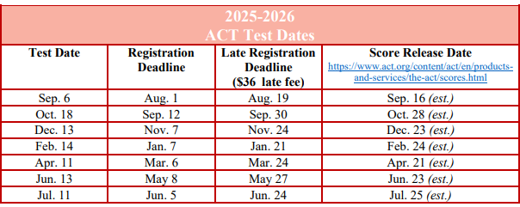

4-Year College/University
Test Requirements
              SAT/ACT test scores are usually required (with explicit score minimums)

Slide 14

SAT/ACT Information
SAT Registration must be completed through College Board. www.collegeboard.org
SAT Fee Waiver Requests
~ Log into their My SAT account.
~ Click "Fee Waiver Request".
~ Complete Application and Provide their coordinators information.
MUST LIST THEIR COUNSELOR (as coordinator) AND USE THE CORRECT EMAIL ADDRESS.
Counselor will complete confirmation email.
PROCESS TAKES ONE TO TWO WEEKS! Request at least a month prior to testing.
ACT Registration must be completed on the Act Website. www.act.org
ACT Fee Waiver Requests
  ~ Email counselor for ACT Waiver Code
  **Counselors cannot register them for these exams, they must go directly to the websites to register.
  ** Fee Waivers are based on Free/Reduced lunch eligibility.
  **The Free/Reduced lunch application MUST be completed/submitted every year.
CEEB Code: 112745

Slide 15
6 Steps to the College Process
                *Determine what college(s) they are applying to & know their deadline(s)
                Determine the application type(s) – i.e., Common App, Common Black College App, Direct to Institution
                Complete their online profile/submit application(s)
                Pay application fee(s) or use fee waiver
                Send test scores directly from the sites (College Board/ACT) – this cannot be done by HS!
                Use Naviance – our “delivery system” – to: (1) Send the official transcript and/or (2) Obtain teacher letter of recommendations
                Remember – as the student/applicant, they need to be sure to track their admissions status directly from the institutions’ websites.
                *It is highly recommended that they take college campus tours!
                Most (if not all) are free of charge and can easily be scheduled online directly from the college/university's websites.

Slide 16

GEORGIA MATCH
GEORGIA MATCH is a simple way for you to know where you are eligible for admission (to be admitted to college), based on your high school calculated HOPE grade point average (GPA) through 11th grade.
Note: GEORGIA MATCH works with public and private accredited high schools in Georgia only.
A senior’s GEORGIA MATCH colleges are found on one’s GAfutures Student Dashboard.
Letters will be mailed home directly from GA Futures in October.

Slide 17
Naviance
Naviance is a delivery system and college/career search engine and also how we communicate with students and parents throughout the school year.

Slide 18
Multiple Uses for Naviance
Available to students online, 24/7!
College Planning
College Search, College Visits, Letters of Recommendation, Transcript Requests
Scholarship Searches
College-specific, National Search, CCSD-specific
Communicating with the School Counselors
E-Mail Capabilities
Career Planning & Resume Building
Explore Careers, Clusters & Pathways
Self-Discovery
Personality, Skills, and Strengths Assessments

Slide 19
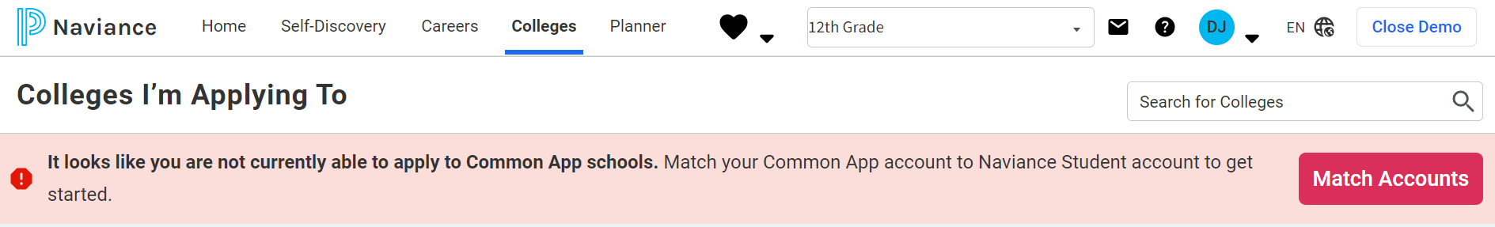
Common App Matching
Common App
  Undergraduate College Admission Application
  Apply to 1,000+ member colleges and universities
Students are required to match their Common App and Naviance Student accounts.
In order to match the Common App account, students must:
  (1) Create a Common App account
  (2) Complete the Education section of the Common App
  (3) Sign the FERPA Release Authorization in the Common App
  Once completed, select “Match Accounts” from Naviance – pictured below.
  NOTE: Not all colleges and universities are on Common App. Some have their own, individual applications
  that can be found on the school’s undergraduate admissions website.

Slide 20
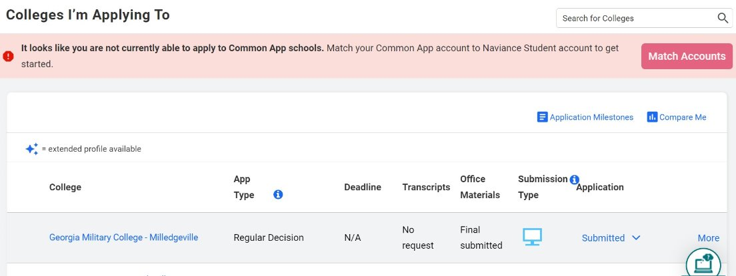
“Colleges I’m Applying To”
After matching their Common App account, their colleges/universities listed there will auto populate here.
  Transmission of important documents, like letters of recommendation and official transcripts, can be completed through Naviance. (even non-Common App Schools)
  - Be sure to indicate “Direct to Institution” for these non-Common App schools.
    This is also where they will request Teacher Letters of Recommendation.

Slide 21
Letters of Recommendation
Allow at least 2-3 school weeks for teacher(s) to complete their recommendation portion of the application!​​
Students “invite” their teacher(s) to upload and send letters of recommendation in two steps: ​
(1) Provide teachers with a copy of academic/extracurricular resume or Senior Brag Sheet
(include a list of colleges/universities).​
(2) Add the request under their “Colleges I’m Applying To” tab from Naviance.
IMPORTANT: ASSIGN TEACHERS TO INDIVIDUAL SCHOOLS – NOT “All Applications”.
-If the school does not require a teacher letter of recommendation, they do not use it in the admissions process.
DO NOT ASK TEACHERS FOR ONE IF THIS IS THE CASE!
**Identifying the Schools that require letters of recommendation is the student’s responsibility.
**Senior Brag Sheet is located in Naviance (please complete prior to asking for a letter to be written)

Slide 22
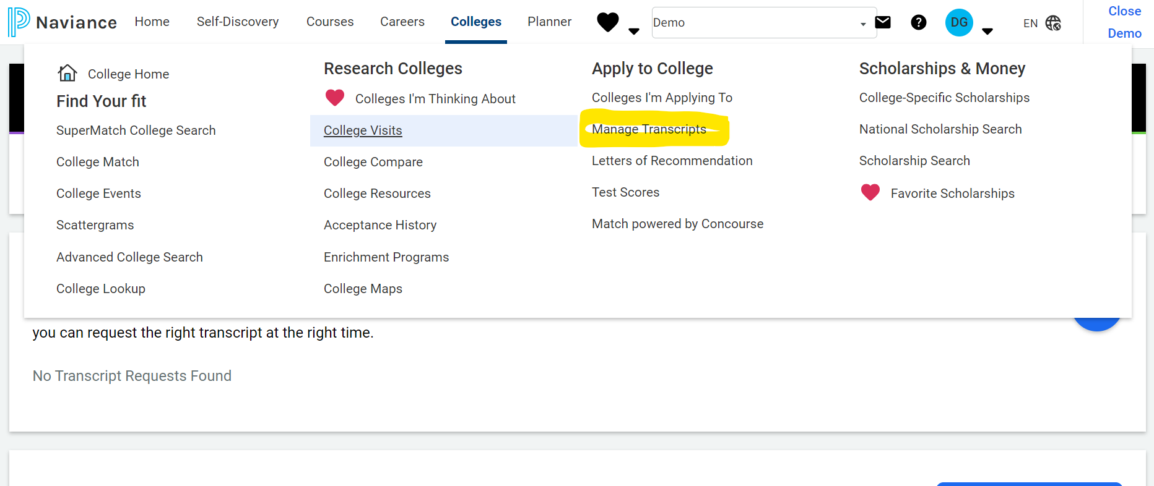
Official Transcript Request
After adding the colleges in Naviance, they will request their transcript directly from Naviance. See picture below.

Slide 23
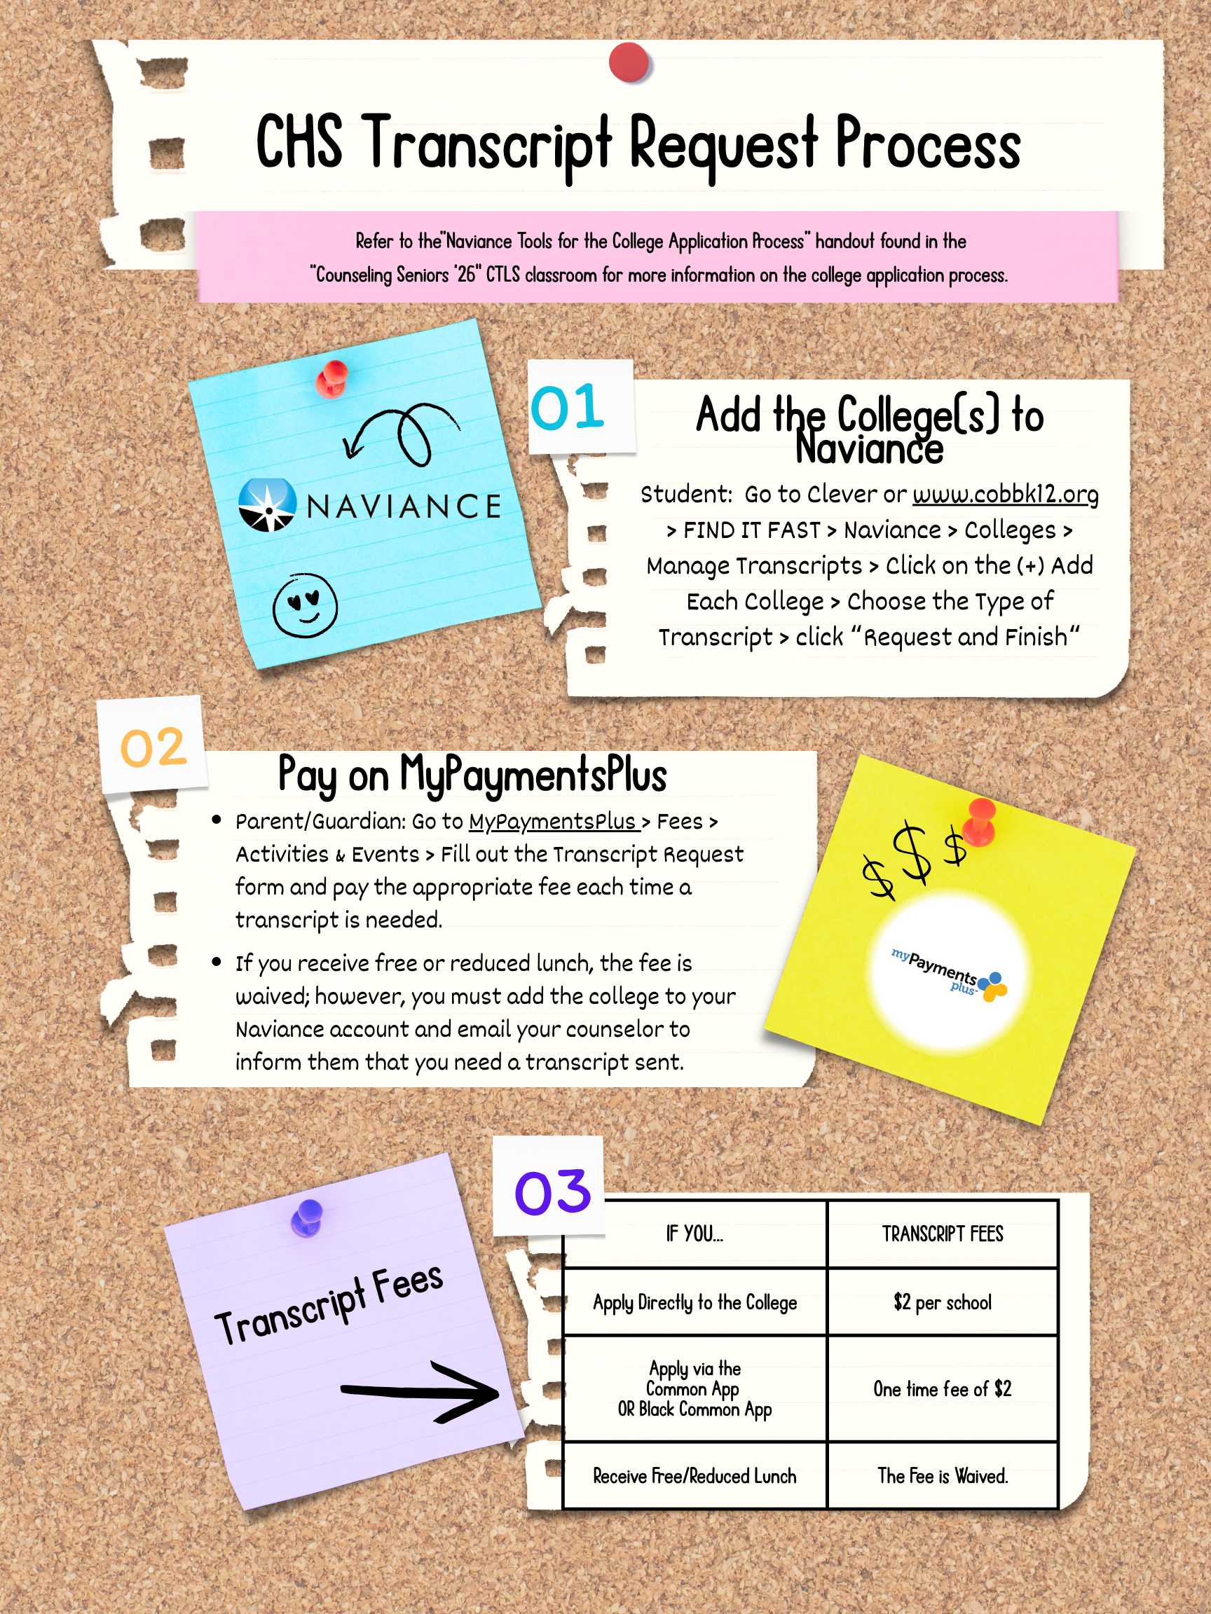
Official Transcript Request

Slide 24
College & Career

Slide 25
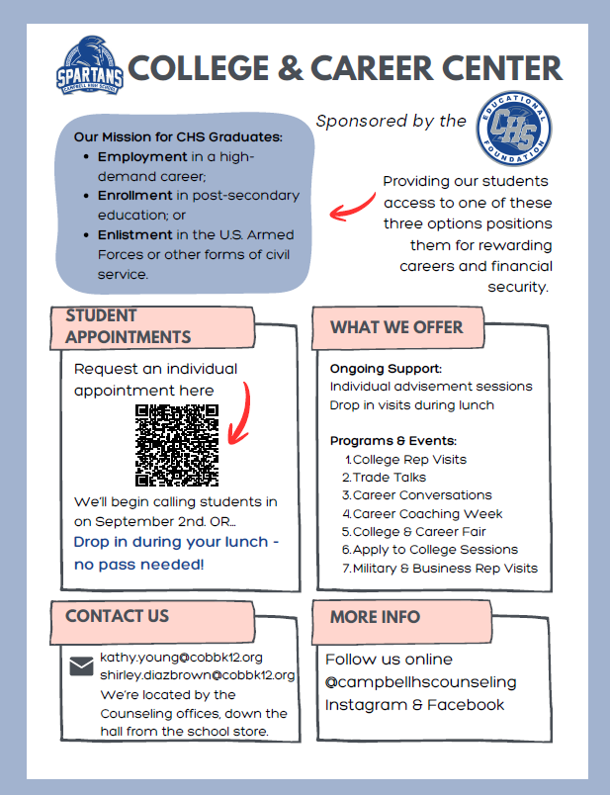
College & Career Center

Slide 26
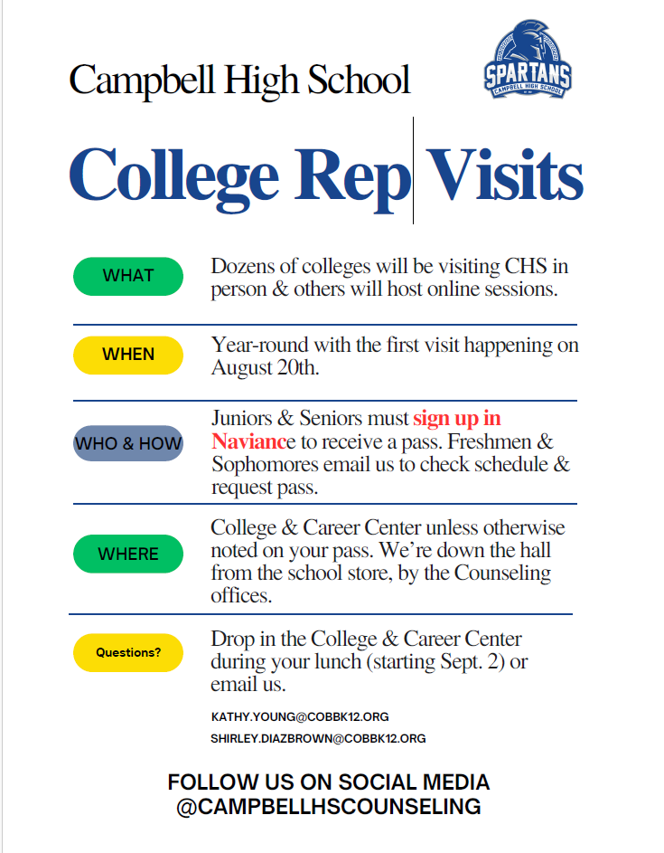
College Visits
This is our student’s opportunity to hear from various college admission representatives who visit to share information about their college/university and its respective admissions process.
Students must sign up through their Naviance account at least 24 hours in advance to attend sessions

Slide 27
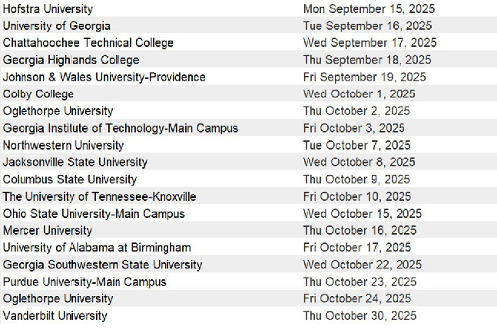
College Visits

Slide 28

College & Career Center

Slide 29
Scholarship Information

Slide 30
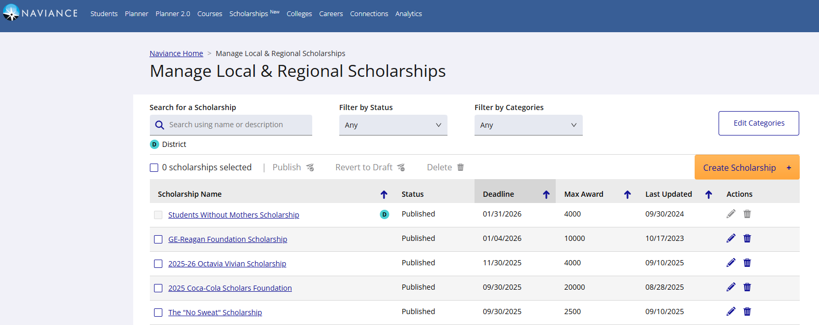
              Paying for College - Scholarships
              CHS Counselors have provided a list of scholarship resources.
              THERE ARE SO MUCH MORE OUT THERE!
              Naviance is a starting place for students:
Going Merry, FastWeb, Scholly

Slide 31
Helpful Websites for Senior Year
ACT: https://www.act.org/
Big Future: https://bigfuture.collegeboard.org/
Cobb County School District: https://www.cobbk12.org/
Common App: https://www.commonapp.org/
Common Black College App: https://commonblackcollegeapp.com/
FAFSA: https://studentaid.gov/h/apply-for-aid/fafsa
GAFutures: https://www.gafutures.org/
SAT (Collegeboard): https://www.collegeboard.org/

Slide 32
Other Academic Programs and Options

Slide 33
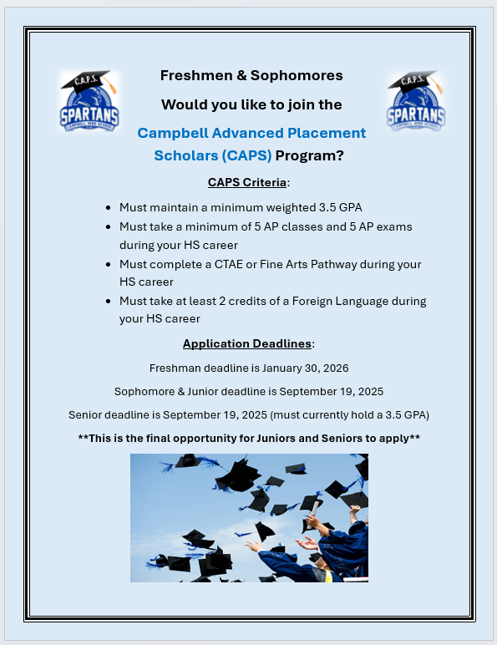
CAPS Program
Campbell AP Scholars (CAPS) Program
This program recognizes students who meet the following criteria:
Minimum 3.5 weighted GPA
Have taken a minimum of 5 AP classes during high school career
Have taken a minimum of 5 AP exams during high school career
Have taken at least two semesters of a World Language
Have completed a CTAE or Fine Arts pathway
Applications must be submitted by September 19th.
Refer to our school website for additional information.

Slide 34
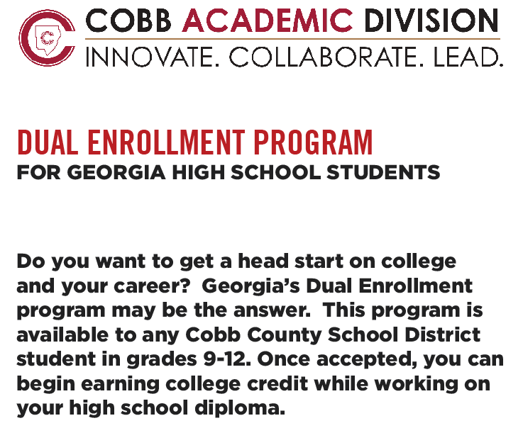

Slide 35

Dual Enrollment

Slide 36
Class of 2026
Senior Information

Slide 37

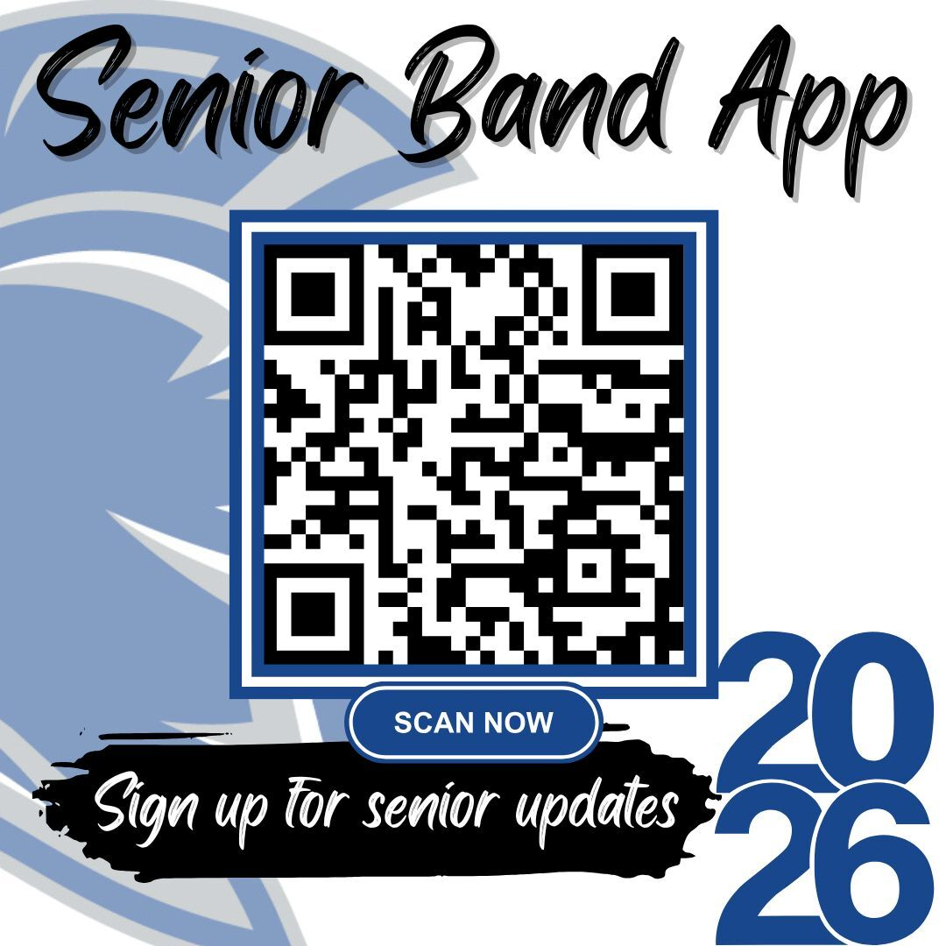
STAY IN THE KNOW..
CHS

Slide 38

CLASS OF 2026

Slide 39
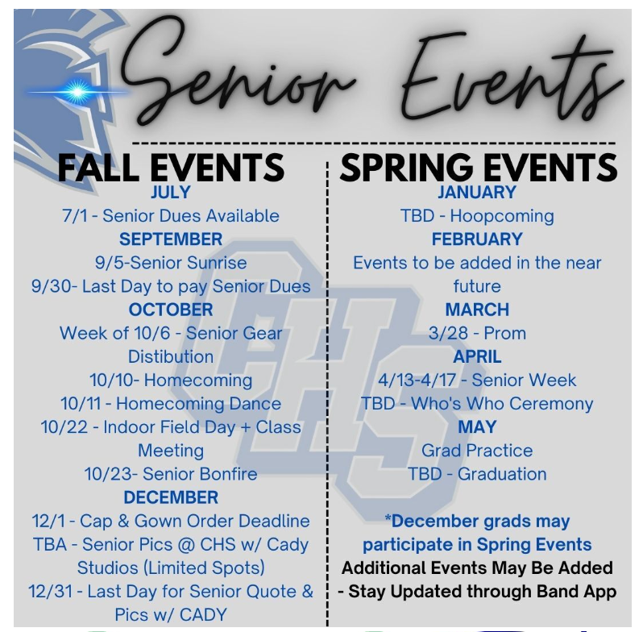
Have a Great Senior Year!

Slide 40
Questions

